Slide 1
AdaGrad

Slide 2
Motivating AdaGrad (Duchi, Hazan, Singer 2011): Often have high-dimensional feature spaces – Many features are irrelevant – Rare features are often very informative

Slide 3
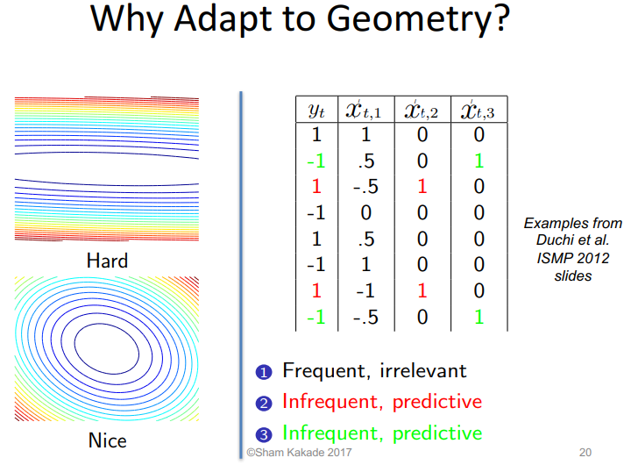

Slide 4
1. Initialization: AdaGrad starts by initializing a separate learning rate for each parameter in the model. Initially, all learning rates are set to a small positive value (e.g., 0.01).
2. AdaGrad maintains a unique learning rate that is specific to that parameter. This learning rate is adjusted throughout the training process.
3. Scaling the Learning Rates: AdaGrad then scales the learning rates for each parameter based on the historical gradient information. Specifically, it divides the initial learning rate by the square root of the cumulative sum of squared gradients for that parameter up to the current iteration.
This has the effect of decreasing the learning rate for parameters that have been updated frequently and increasing it for parameters that have been updated less frequently.
wi,t+1​=wi,t​−αi,t​⋅∇J(wi,t​),
=>parameter wi​ at iteration t.

Slide 5
AdaGrad tends to give smaller updates to frequently changing parameters and larger updates to parameters that have been relatively stable.
This adaptiveness can be beneficial for improving convergence and training stability, especially when dealing with sparse data or features.
However, one potential drawback of AdaGrad is that the learning rates can become too small over time, which can slow down convergence in the later stages of training. To address this, other optimization algorithms like RMSprop and Adam have been developed, which build upon the concepts of AdaGrad while introducing additional adaptations.

Slide 6
Recall
If using MSE, and linear activation (y = mx + c), then:
MSE= Σ(actual_y - predicted_y)²
n
dMSE/dm = -2 * Σ x * (actual_y - predicted_y) / n
dMSE/dc = -2 * Σ(actual_y - predicted_y) / n
What will happen if some values of x (some feature) are small or even 0?
dMSE/dm will be close to 0 or 0 for many values

Slide 7
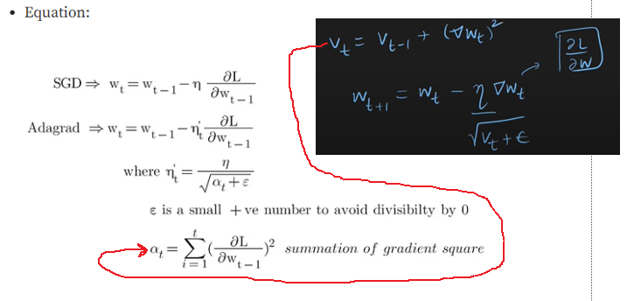

Slide 8
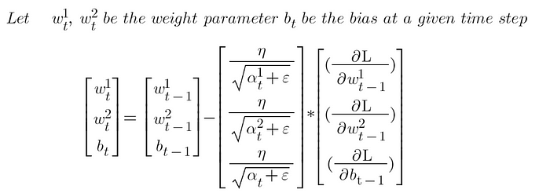

Slide 9
References
https://courses.cs.washington.edu/courses/cse547/17sp/slides/adaptive_gradient_methods_annotated.pdf
https://medium.com/@pavankumar_A.I/adagrad-optimizer-b302fb7ab7ad
https://www.youtube.com/watch?v=nqL9xYmhEpg

